Slide 1
Basic Elements and Attributes

Slide 2
Objectives
Form Elements
Form Attributes
Comments

Slide 3
Basic Elements
The HTML <head> Element
The HTML <head> element has nothing to do with HTML headings.
The HTML <head> element contains meta data. Meta data are not displayed.
The HTML <head> element is placed between the <html> tag and the <body> tag:

Slide 4
The HTML <title> Element
The HTML <title> element is meta data. It defines the HTML document's title.
The title will not be displayed in the document, but might be displayed in the browser tab.

Slide 5
The HTML <meta> Element
The <meta> element is used to specify page description, keywords, author, and other metadata.
Metadata is used by browsers (how to display content), by search engines (keywords), and other web services.
Define keywords for search engines:
<meta name="keywords" content="HTML, CSS, XML, XHTML,
JavaScript">
Define a description of your web page:
<meta name="description" content="Free Web tutorials on HTML
and CSS">

Slide 6
The HTML <meta> Element
Define the character set used:
<meta charset="UTF-8">
Define the author of a page:
<meta name="author" content="HegeRefsnes">
Refresh document every 30 seconds:
<meta http-equiv="refresh" content="30">

Slide 7
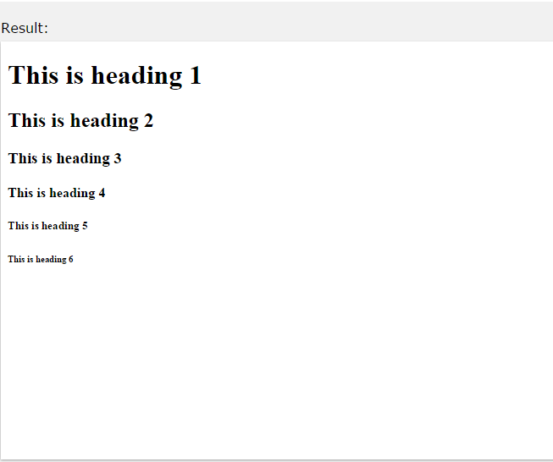
HTML Headings
Headings are important in HTML documents.
Headings are defined with the <h1> to <h6> tags. <h1> defines the most important heading. <h6> defines the least important heading.
<h1>This is a heading</h1>
<h2>This is a heading</h2>
<h3>This is a heading</h3>
Note: Browsers automatically add some empty space (a margin) before and after each heading.

Slide 8
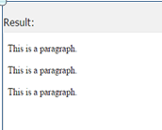
HTML Paragraphs
HTML paragraphs are defined with the <p> tag: Example
<p>This is a paragraph.</p>
<p>This is another paragraph.</p>

Slide 9
HTML Line Breaks
The HTML <br> element defines a line break.
Use <br> if you want a line break (a new line) without starting a new paragraph:
Example
<p>This is<br>a para<br>graph with line breaks</p>

Slide 10
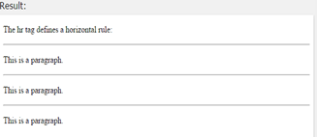
HTML Horizontal Rules
The <hr> tag creates a horizontal line in an HTML page. The hr element can be used to separate content:
Example
<p>This is a paragraph.</p>
<hr>
<p>This is a paragraph.</p>
<hr>
<p>This is a paragraph.</p>

Slide 11
HTML Links
Links are found in nearly all web pages. Links allow users to click their way from page to page.
HTML links are hyperlinks.
A hyperlink is a text or an image you can click on, and jump to another document.
<a href="url">link text</a>
<a href="http://www.w3schools.com/html/">Visit our HTML
tutorial</a>

Slide 12
The target Attribute
The target attribute specifies where to open the linked document.
This example will open the linked document in a new browser window or in a new tab:
Example
<a href="http://www.w3schools.com/" target="_blank">Visit
W3Schools!</a>

Slide 13
The target Attribute
Target Value | Description
_blank | Opens the linked document in a new window or tab
_self | Opens the linked document in the same frame as it was clicked (this is default)
_parent | Opens the linked document in the parent frame
_top | Opens the linked document in the full body of the window
framename | Opens the linked document in a named frame

Slide 14
Create a Bookmark
HTML bookmarks are used to allow readers to jump to specific parts of a Web page.
Bookmarks are practical if your website has long pages.
To make a bookmark, you must first create the bookmark, and then add a link to it.
When the link is clicked, the page will scroll to the location with the bookmark.

Slide 15
The target Attribute
Example
First, create a bookmark with the id attribute:
<h2 id="tips">Useful Tips Section</h2>
Then, add a link to the bookmark ("Useful Tips Section"), from within the same page:
<a href="#tips">Visit the Useful Tips Section</a>
Or, add a link to the bookmark ("Useful Tips Section"), from another page:
Example
<a href="html_tips.html#tips">Visit the Useful Tips Section</a>

Slide 16
HTML Images Syntax
In HTML, images are defined with the <img> tag.
The <img> tag is empty, it contains attributes only, and does not have a closing tag.
The src attribute specifies the URL (web address) of the image:
<img src="url" alt="some_text">

Slide 17
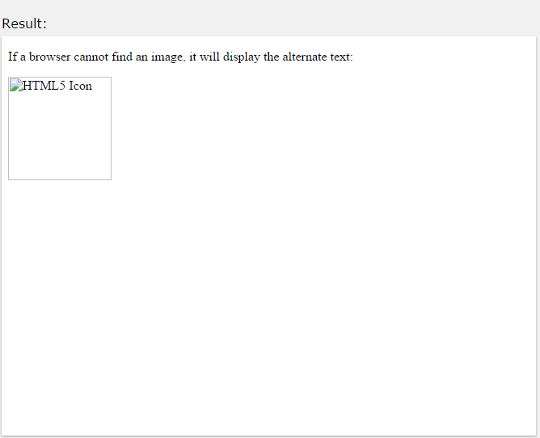
The alt Attribute
The alt attribute specifies an alternate text for an image, if the image cannot be displayed.
The alt attribute provides alternative information for an image if a user for some reason cannot view it (because of slow connection, an error in the src attribute, or if the user uses a screen reader).
If a browser cannot find an image, it will display the alt text:
<img src="wrongname.gif" alt="HTML5
Icon" style="width:128px;height:128px;">

Slide 18
Image Size - Width and Height
You can use the style attribute to specify the width and height of an image.
The values are specified in pixels (use px after the value):
<img src="html5.gif" alt="HTML5
Icon" style="width:128px;height:128px;">
Alternatively, you can use width and height attributes. Here, the values are specified in pixels by default:
<img src="html5.gif" alt="HTML5
Icon" width="128" height="128">

Slide 19
Images in Another Folder
If not specified, the browser expects to find the image in the same folder as the web page.
However, it is common to store images in a sub-folder. You must then include the folder name in the src attribute:
Example
<img src="/images/html5.gif" alt="HTML5
Icon" style="width:128px;height:128px;">

Slide 20
Images on Another Server
Some web sites store their images on image servers.
Actually, you can access images from any web address in the world:
Example
<img src="http://www.w3schools.com/images/w3schools_green.j
pg" alt="W3Schools.com">

Slide 21
Using an Image as a Link
To use an image as a link, simply nest the <img> tag inside the <a> tag:
Example
<a href="default.asp">
<img src="smiley.gif" alt="HTML
tutorial" style="width:42px;height:42px;border:0;">
</a>

Slide 22
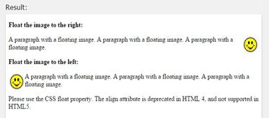
Image Floating
Use the CSS float property to let the image float.
The image can float to the right or to the left of a text:
<p>
<img src="smiley.gif" alt="Smiley
face" style="float:right;width:42px;height:42px;"> The image will float to the right of the text.
</p>
<p>
<img src="smiley.gif" alt="Smiley
face" style="float:left;width:42px;height:42px;"> The image will float to the left of the text.
</p>

Slide 23
2.1.9.10 Image Maps
Use the <map> tag to define an image-map. An image-map is an image with clickable areas.
The name attribute of the <map> tag is associated with the
<img>'s usemap attribute and creates a relationship between the image and the map.
The <map> tag contains a number of <area>tags, that defines the clickable areas in the image-map:

Slide 24
Image Maps
Example
<img src="planets.gif" alt="Planets" usemap="#planetmap" style
="width:145px;height:126px;">
<map name="planetmap">
<area shape="rect" coords="0,0,82,126" alt="Sun" href="sun.ht m">
<area shape="circle" coords="90,58,3" alt="Mercury" href="mer
cur.htm">
<area shape="circle" coords="124,58,8" alt="Venus" href="venu s.htm">
</map>

Slide 25
HTML Formatting Elements
Formatting elements were designed to display special types of text:
Bold text
Important text
Italic text
Emphasized text
Marked text
Small text
Deleted text
Inserted text
Subscripts
Superscripts

Slide 26

HTML Bold and Strong Formatting
The HTML <b> element defines bold text,
without
any extra
importance. Example
<p>This text is normal.</p>
<p><b>This text is bold</b>.</p>

Slide 27

HTML Italic and Emphasized Formatting
The HTML <i> element defines italic text, without
any extra
importance. Example
<p>This text is normal.</p>
<p><i>This text is italic</i>.</p>

Slide 28
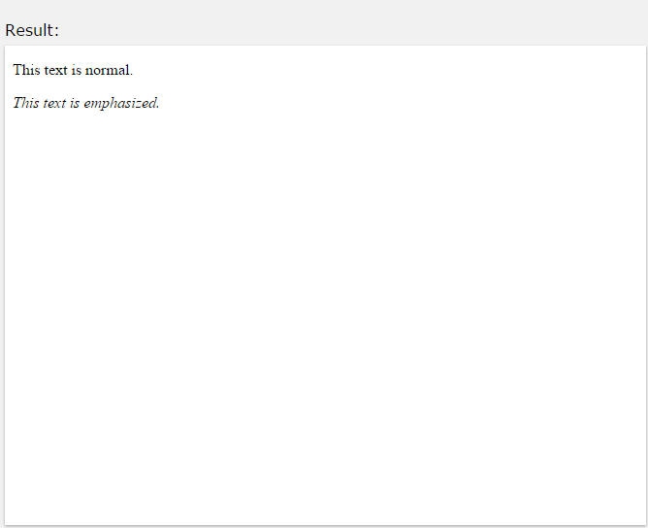
HTML Italic and Emphasized Formatting
The HTML <em> element defines emphasized text, with added semantic importance.
Example
<p>This text is normal.</p>
<p><em>This text is emphasized</em>.</p>

Slide 29
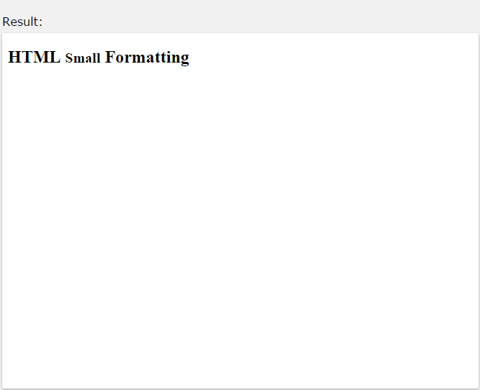
HTML Small Formatting
The HTML <small> element defines small text:
<h2>HTML <small>Small</small> Formatting</h2>

Slide 30
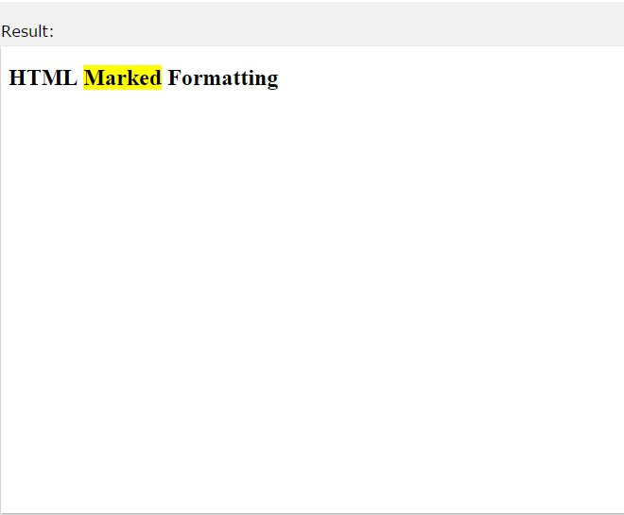
HTML Marked Formatting
The HTML <mark> element defines marked or highlighted text:
<h2>HTML <mark>Marked</mark> Formatting</h2>

Slide 31
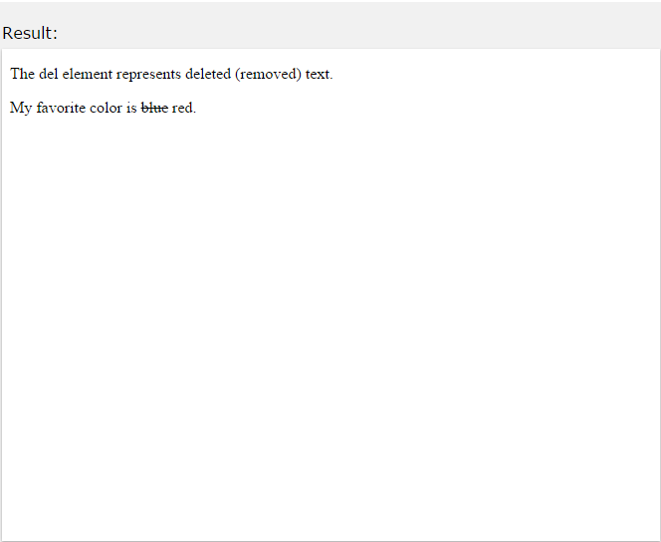
HTML Deleted Formatting
The HTML <del> element defines deleted (removed) text.
<p>My favorite color is <del>blue</del> red.</p>

Slide 32
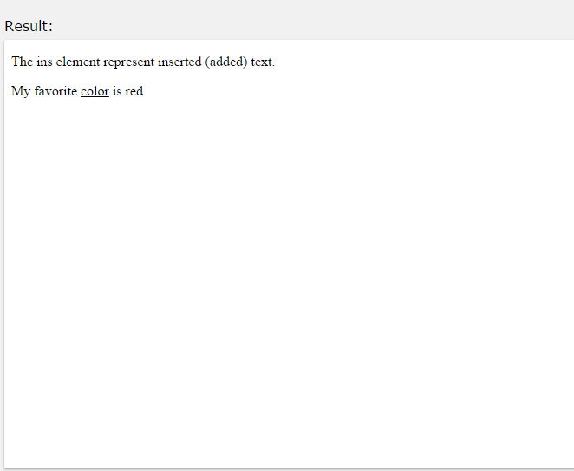
HTML Inserted Formatting
The HTML <ins> element defines inserted (added) text.
<p>My favorite <ins>color</ins> is red.</p>

Slide 33
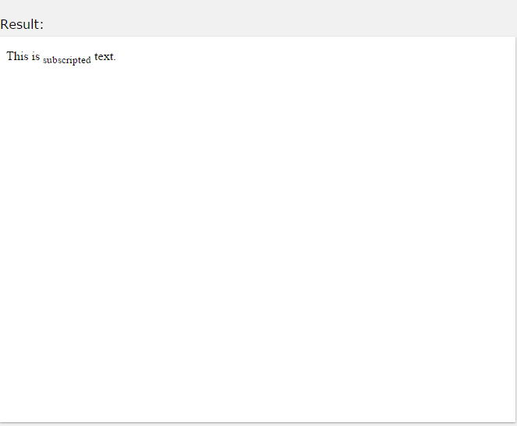
HTML _{Subscript} Formatting
The HTML <sub> element defines subscripted text.
<p>This is <sub>subscripted</sub> text.</p>

Slide 34
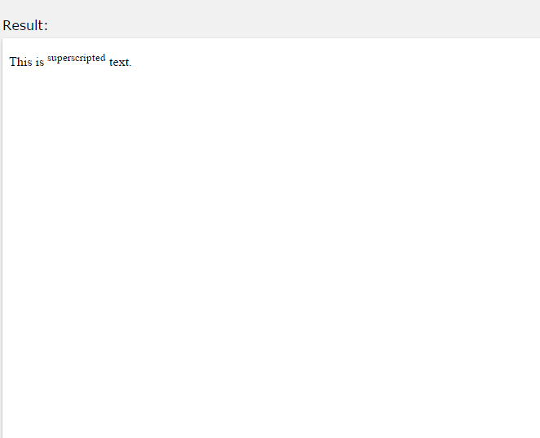
HTML Superscript Formatting
The HTML <sup> element defines superscripted text.
<p>This is <sup>superscripted</sup> text.</p>

Slide 35
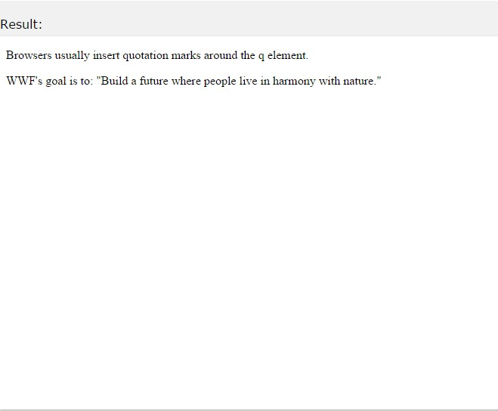
Quotation
The HTML <q> element defines a short quotation.
Browsers usually insert quotation marks around the <q> element.
<p>WWF's goal is to: <q>Build a future where people live in harmony with nature.</q></p>

Slide 36
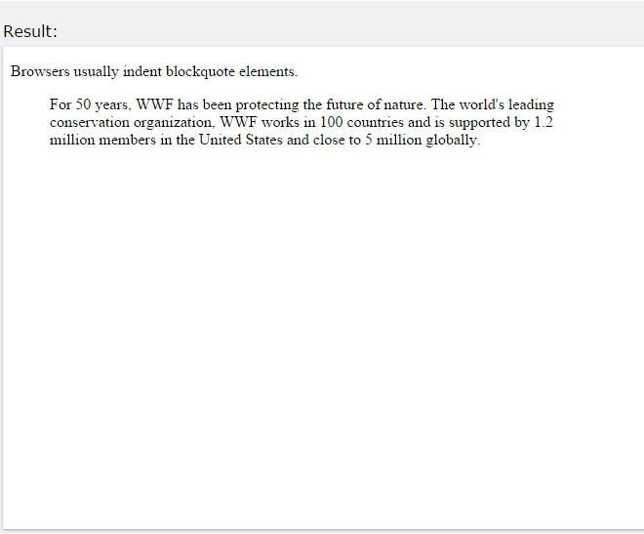
blockquote for Long Quotations.
<p>Here is a quote from WWF's website:</p>
<blockquote cite="http://www.worldwildlife.org/who/index.html"
>
For 50 years, WWF has been protecting the future of nature. The world's leading conservation organization,
WWF works in 100 countries and is supported by
1.2 million members in the United States and close to 5 million globally.
</blockquote>

Slide 37
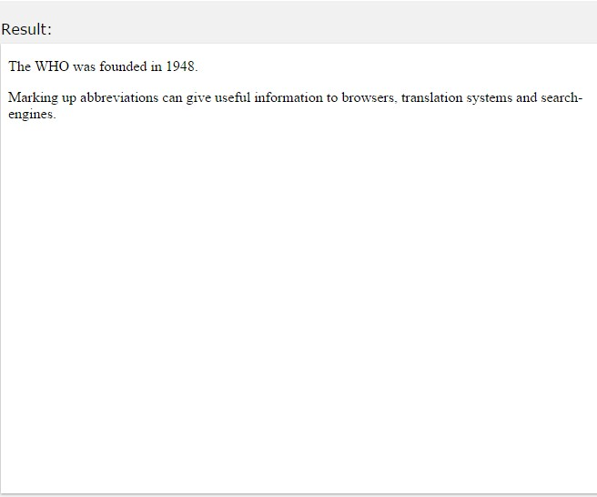
HTML <abbr> for Abbreviations
The HTML <abbr> element defines an abbreviation or an acronym.
Marking abbreviations can give useful information to browsers, translation systems and search-engines.
<p>The <abbr title="World Health
Organization">WHO</abbr> was founded in 1948.</p>

Slide 38
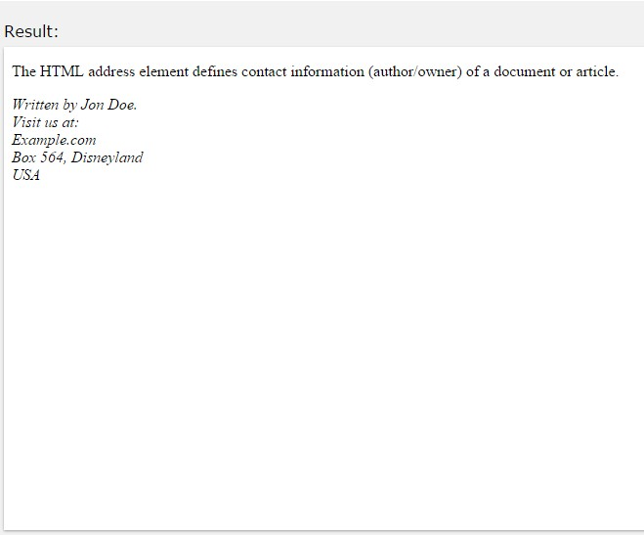
HTML <address> for Contact Information
The <address> element is usually displayed in italic. browsers will add a line break before and after the element.
<address>
Written by Jon Doe.<br> Visit us at:<br> Example.com<br>
Box 564, Disneyland<br> USA
</address>

Slide 39
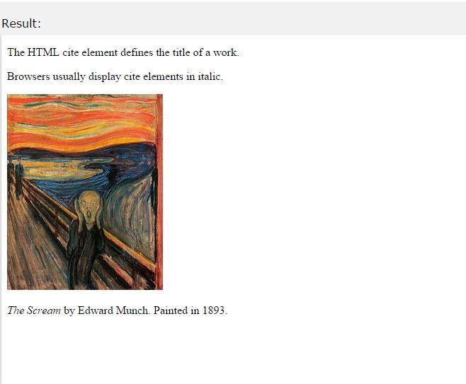
HTML <cite> for Work Title
The HTML <cite> element defines the title of a work. Browsers usually display <cite> elements in italic.
Example
<p><cite>The Scream</cite> by Edward Munch. Painted in
1893.</p>

Slide 40
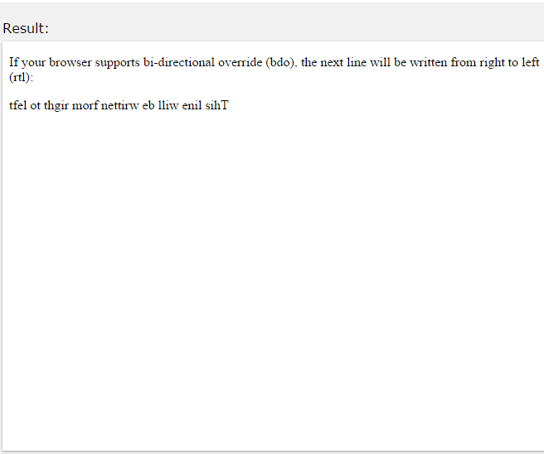
HTML <bdo> for Bi-Directional Override
The HTML <bdo> element defines bi-directional override.
The <bdo> element is used to override the current text direction:
<bdo dir="rtl">This text will be written from right to left</bdo>

Slide 41
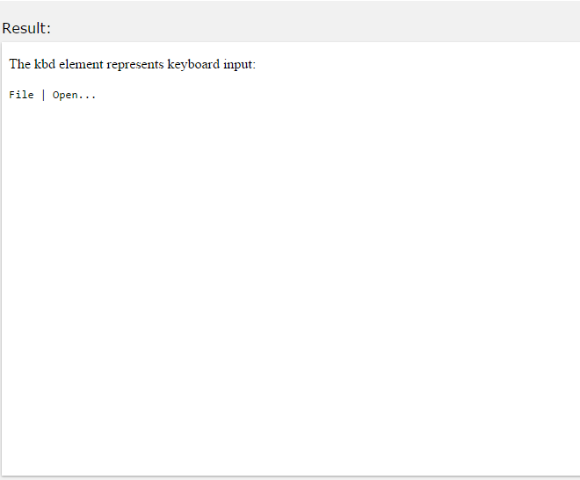
HTML <kbd> For Keyboard Input
The HTML <kbd> element defines keyboard input:
<kbd>File | Open...</kbd>

Slide 42
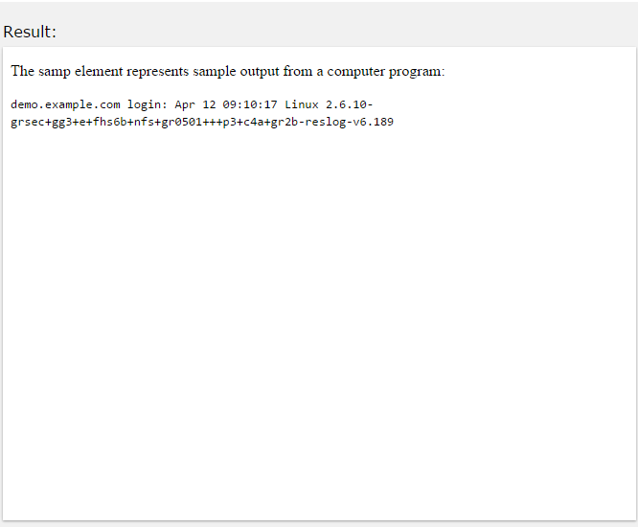
HTML <samp> For Computer Output
The HTML <samp> element defines sample
output
from a
computer program:
<samp>
demo.example.com login: Apr 12 09:10:17
Linux 2.6.10-grsec+gg3+e+fhs6b+nfs+gr0501+++p3+c4a+gr2b- reslog-v6.189
</samp>

Slide 43
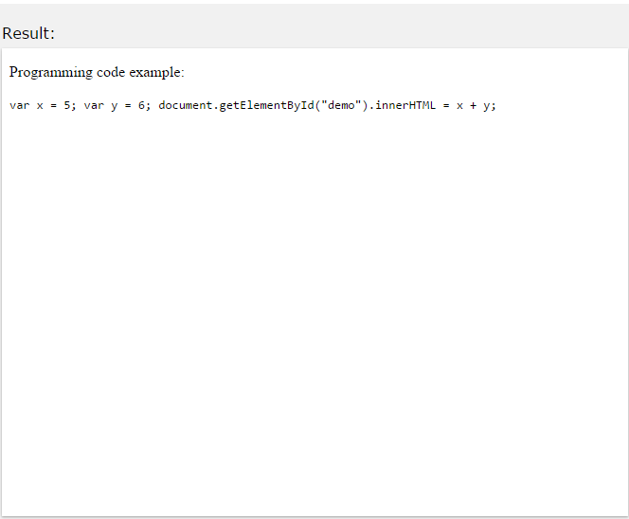
HTML <code> For Computer Code
The code:
HTML <code> element defines a piece
of programming
<code>
var x = 5; var y = 6;
document.getElementById("demo").innerHTML = x + y;
</code>

Slide 44
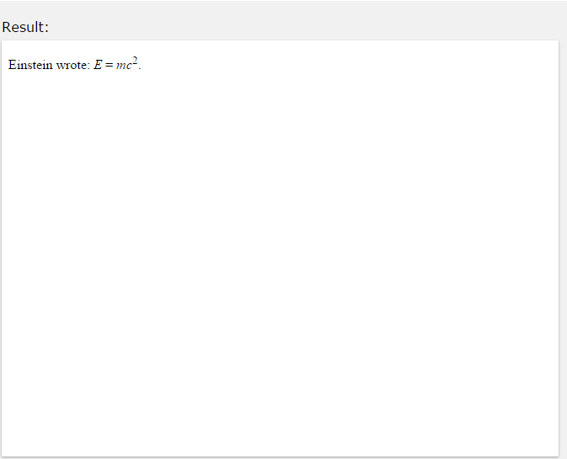
HTML <var> For Variables
The HTML <var> element defines a variable.
The variable could be a variable in a mathematical expression or a variable in programming context:
Einstein
wrote: <var>E</var> = <var>m</var><var>c</var><sup>2</sup
>.

Slide 45
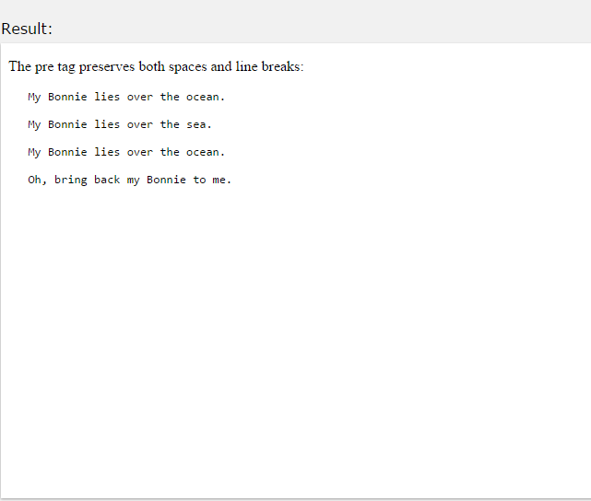
The HTML <pre> Element
The HTML <pre> element defines preformatted text.
The text inside a <pre> element is displayed in a fixed-width font (usually Courier), and it preserves both spaces and line breaks:
<pre>
My Bonnie lies over the ocean.
My Bonnie lies over the sea. My Bonnie lies over the ocean.
Oh, bring back my Bonnie to me.
</pre>

Slide 46

Attributes
The HTML Style Attribute
Setting the style of an HTML element, can be done with the style attribute.
The HTML style attribute has the following syntax: style="property:value;"
The property is a CSS property. The value is a CSS value.
You will learn more about CSS later in this tutorial.

Slide 47
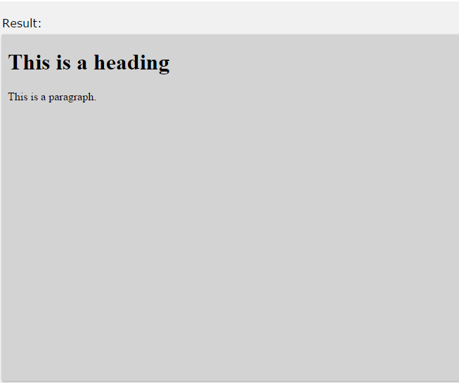
HTML Background Color
The background-color property defines the background color for an HTML element:
This example sets the background for a page to lightgrey:
Example
<body style="background-color:lightgrey;">
<h1>This is a heading</h1>
<p>This is a paragraph.</p>
</body>

Slide 48
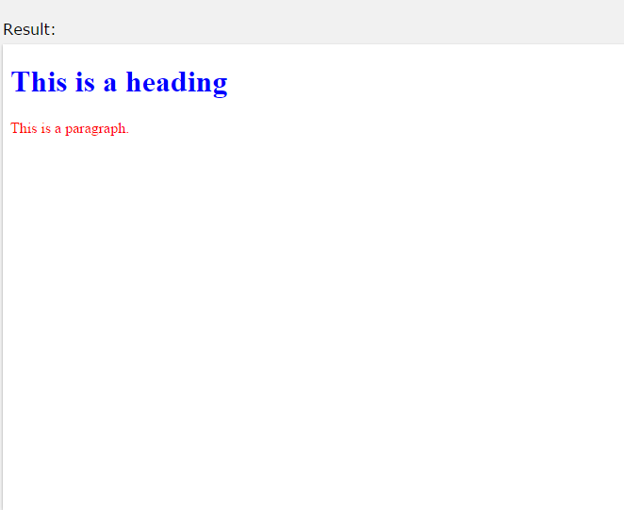
HTML Text Color
The color property defines the text color for an HTML element:
<h1 style="color:blue;">This is a heading</h1>
<p style="color:red;">This is a paragraph.</p>

Slide 49
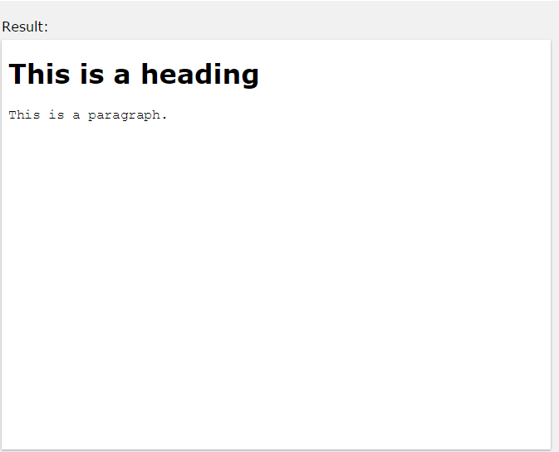
HTML Fonts
The font-family property HTML element:
Example
defines
the font
to be used
for an
<h1 style="font-family:verdana;">This is a heading</h1>
<p style="font-family:courier;">This is a paragraph.</p>

Slide 50
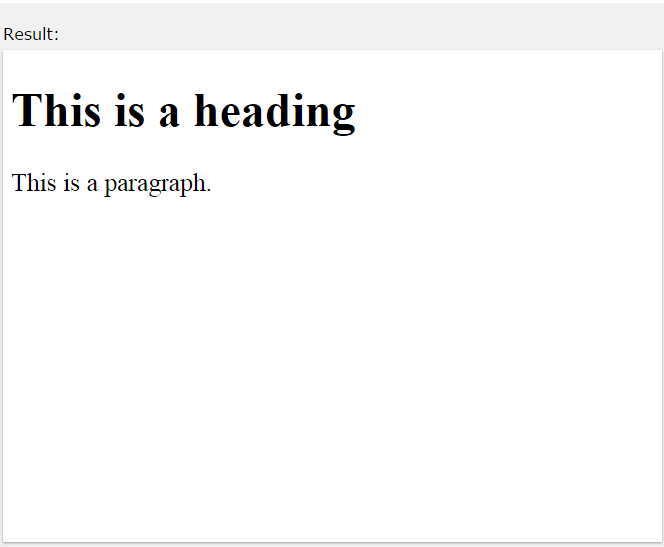
HTML Text Size
The font-size property element:
defines
the text
size
for an HTML
<h1 style="font-size:300%;">This is a heading</h1>
<p style="font-size:160%;">This is a paragraph.</p>

Slide 51
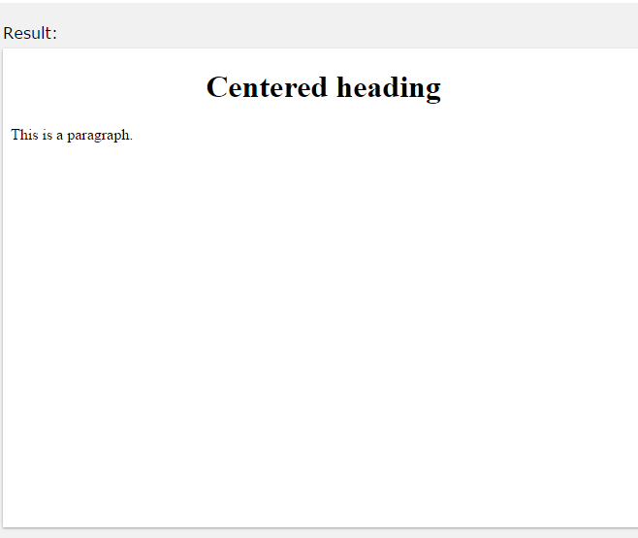
HTML Text Alignment
The text-align property defines the horizontal text alignment for an HTML element:
Example
<h1 style="text-align:center;">Centered Heading</h1>
<p>This is a paragraph.</p>

Slide 52
HTML Comments
Comment tags <!-- and --> are used to insert comments in HTML.
HTML Comment Tags
You can add comments to your HTML source by using the following syntax:
<!-- Write your comments here -->
Note: There is an exclamation point (!) in the opening tag, but not in the closing tag.

Slide 53
Conditional Comments
You might stumble upon conditional comments in HTML:
<!--[if IE 8]>
.... some HTML here ....
<![endif]-->
Conditional comments defines HTML tags to be executed by Internet Explorer only.

